Slide 1



Satan’s
If I Were
MINISTER
(part 6)

Slide 2

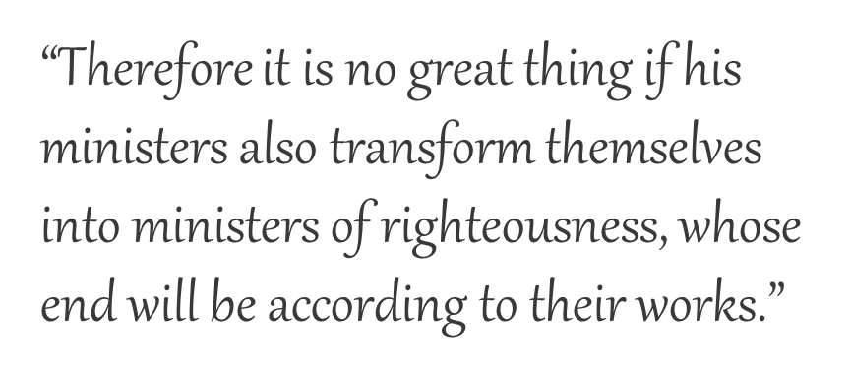
Previously:
If I Were Satan’s Minister, I would:
Teach that someone like me does not exist
Promote the one-man-pastor system
Emphasize sincerity over truth
Embrace all forms of worship
Embrace Calvinism
2 Corinthians 11:15
Notes:
Previously we spoke of salvation being wholly of grace which is responsible for the teaching that says it is all of God and none of me. We will continue to unravel this in this lesson and the next.

Slide 3
Essentials of Calvinism:
2 Corinthians 11:15
“Wholly of grace”
“Salvation is all of God and none of me”
“Faith is a gift of God”
“Salvation is by faith alone”
Etc.
Notes:
The current major section of this series is, as Satan’s minister, I would embrace Calvinism. I previously exposed the folly of Calvin’s position of salvation being wholly of grace. This lie has led to the teaching that asserts “Salvation is all of God and none of me.” When we point out that salvation is also by faith, they counter by asserting even faith is a gift of God and this lead to the idea of “Salvation is by faith alone.” You can see the slick slithering sneaky snake effect of this. As we have exposed the error in all of these points mentioned, we will continue to unravel the Calvinistic web of lies in this lesson and the next.

Slide 4


If I were Satan’s Minister…
“Faith and repentance are two sides of the same coin.”
I would teach that faith and repentance occur at the same time—a change of mind.
Notes:
There is a certain strain from the Scriptures to get men to repent. John preached a baptism of repentance. Jesus commanded repentance to be preached to all nations (Lk. 24:47). This gospel message to provoke men to change began in Jerusalem and was later carried into the whole world (Acts 2:38; 17:30; 26:20). But what does it mean to get men to repent? Some say, it only means to get them to change their mind and hence it is simply a part of faith. Hiscox’s Standard Manual for Baptist Churches says that faith and repentance are inseparable graces (p. 64).

Slide 5
REPENTANCE
The teaching of men versus the teaching of God
Is “repentance” simply a change of mind?
Notes:
Our subject for today is repentance. We want to compare mans’ thinking to God’s and in doing so, establish a clear concept of this essential quality. Is repentance simply a change of mind as some of our Calvinist friends assert?

Slide 6



Jesus & Jonah
Matthew 12:41
Jonah 3:10
Nineveh repented at the preaching of Jonah
God saw their works, that they turned from their evil way
Jesus defined repentance as the “work” of turning from evil!
Notes:
So we know right here what a definition of repentance is. It is a Jesus-approved definition. Repentance means turning from sin!

Slide 7

Man’s Ways Lead To The Exclusion of REPENTANCE
3 Reasons Why I Don’t Preach On Repentance
(“Turn from Sin”)
Paul Ellis
“Religious people often complain that
we grace preachers don’t emphasize repentance sufficiently. It’s true. I hardly emphasize it at all. But then neither did the Apostle John.”
Notes:
https://escapetoreality.org/2011/11/28/3-reasons-why-i-dont-preach-on-repentance/

Slide 8
Man’s Ways Lead To The Exclusion of REPENTANCE
3 Reasons Why I Don’t Preach On Repentance
(“Turn from Sin”)
Paul Ellis
“Here’s something that will fry your mind: Repentance is one of the most important
things you’ll ever do but John never mentions it. Not once. Not in his gospel or in any of his three letters. I guess John must’ve been a grace preacher.”
Notes:
https://escapetoreality.org/2011/11/28/3-reasons-why-i-dont-preach-on-repentance/

Slide 9

“The entirety of Your word is truth, And every one of Your righteous judgments endures forever” (Psa. 119:160)
Notes:
Are John’s Gospel and his three short epistles the entirety of truth? Do they represent the whole truth and the entirety of God’s? If so, why are there the other twenty-three books of the New Testament? When Peter preached “repentance” Acts 2:38, 3:19; 5:31, did John or any apostle oppose him?

Slide 10
How Important Was REPENTANCE to the Apostle John?

Slide 11
In Revelation
Where sin existed in the seven churches
For the rest of mankind
Ephesus, 2:5
Pergamos, 2:16
Thyatira, 2:21, 22
Sardis, 3:3
Laodicea, 3:19
Revelation 9:20, 21
Revelation 16:9, 11
REPENT!
TEN TIMES in REVELATION!
REPENT!

Slide 12
In What He Saw Required of Others
The diseased man
  John 5:1-14
The woman caught in adultery
  John 8:1-11
Notes:
John 5:1-14. It is hard to imagine such a poor, diseased fellow being guilty of sin. Even he was.In some ways he reminds me of Job who, while in extreme adversity was called to repent and did repent (Job 40:1-5; 42:1-6).
John 8:1-11. During the last week, it seems that Jesus retired on the Mount of Olives and then taught early in the morning in the outer court of the temple (8:2). He attracted a large public gathering “all the people” (8:2). The scribes would often use this area to teach, but it seems that when Jesus was there, the people were not so much interested in the other teachers.
The Scribes were likely jealous of this attention and interrupted the Lord’s teaching by bringing a woman to him whom they charged with committing adultery. What is evident is that they held her to a different standard than the man. Their motives were not pure, but they sought to contradict Jesus and showcase Him as out of line with Moses.
Think of the predicament this woman found herself in. I doubt she thought her decision to engage in a very private sin would land her into this open situation. It was very early in the morning (M. Text). She had likely been snatched away that very evening/morning and was rushed into the courtyard of the temple, placed in the midst of the public, and exposed to humiliation and shame. The man guilty of adultery was not. One could speculate on all the angles of this scheme which the Pharisees were involved. However, sin is never advertised with its cost, only its appeals. It presents itself in one light that is fun, attractive, and enticing and then it takes us to places of pain, guilt, deep shame and even death.
Every person has the capacity to sin. Every person has a weakness which the devil can exploit. I doubt seriously that this woman thought she would end up in this situation the day before. Had she not listened to that seductive lie, had self-control crashed in breaking down her desire for evil, had a fear of the punishment screamed in her ear, “danger, keep away!” think of what she would have been spared? Had she garnered the strength to say “no” and ran away from the temptation as Joseph did Potiphar’s wife, she would not be in this place, in this crowd, in this shame. It was, without a doubt, overwhelming for this woman at this time. Sin’s seductive desire won her trust. Satan blurred and blinded the consequences of the temptation which captivated her interest and ensnared her soul even as he did with Eve in the Garden and the passion of Cain in the field. If you think I speak hyperbole recognize that in both letters to Timothy Paul warned against Satan’s snare (1 Tim. 3:7; 2 Tim. 2:26). They become a snare because we do not see the full impact of his bait in the lust of the eyes, flesh, and pride of life. This woman yielded to temptation and became trapped to where spiritually and physically only Jesus could set her free. It is an often repeated scene, unfortunately. But Jesus wants to free us even as He wanted to release her (2 Tim. 2:25). She was fully pardoned. This woman’s sin would no longer be held against her by the Lord (v. 11). But then He tells her to go and sin no more. That is repentance. It is not merely a change in the mind, but it involves a change in action. It is turning from sin.

Slide 13
In What He Saw Required of Others
The people (Jn. 12:20-43)
  “see” + “understand” + “turn” → “heal” (v. 40)
    Turning around—Jn. 21:20
    Turning to the Lord—Acts 3:19; 9:35; etc.
    Turning from sin—Acts 26:18; Jas. 5:19, 20
Notes:
While John did not use the word often translated “repent,” he did use a word which conveyed the same thing here.
Turning to the Lord: also, 14:15; 15:19; 2 Cor. 3:16.

Slide 14

In What Was Required Of Him
A son of thunder (Mk. 3:17)
  “probably…stormy and destructive temper”
  (J. W. McGarvey)
Was zealous to destroy adversaries (Lk. 9:51-58)
Sought preeminence over the other apostles (Mk. 10:35-45)

Slide 15
Transformed
Followed Jesus to His death
Was entrusted with the care of Mary (Jn. 19:25-27)
Lost his brother to Herod’s violence (Acts 12:1, 2)
Thundered against sin (1 Jn. 2:4, 22; 3:15; etc.)
Encouraged the understanding of forgiveness through our Advocate (1 Jn. 2:1, 2, 12)
Emphasized the love of our Father and the relationship of being a child of God (1 Jn. 3:1)

Slide 16
Transformed
Love of God’s children (1 Jn. 3:16-18; 4:7ff)
Why we love God (1 Jn. 4:19)
How we love God (1 Jn. 5:3)
Where our life is (1 Jn. 5:11, 12)
The snare to life (2 Jn. 9-11)
Calling down the pursuit for preeminence
(3 Jn. 9-11)

